Slide 1
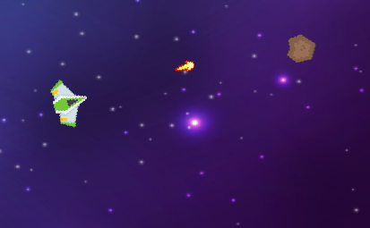
Shooting
Shooting
Player 1
Player 2
Space
J

Slide 2
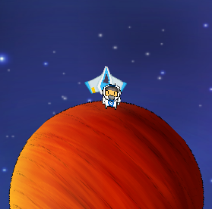
Repairing Spaceship
Enter & Repair Spaceship
Player 1
Player 2
E
I

Slide 3
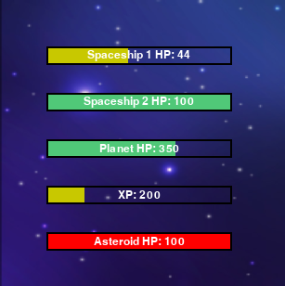
UI
UI Status bars

Slide 4
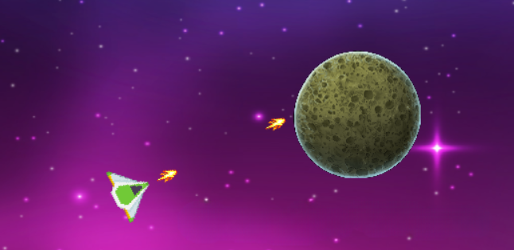


Upgraded Spaceship
UI Status bars
Destroy Asteroid with Upgraded Spaceship

Slide 5
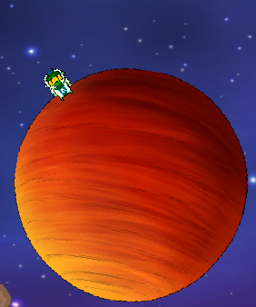
Player Movement
Player Movement
Player 1
A
D
Player 2
←
→

Slide 6
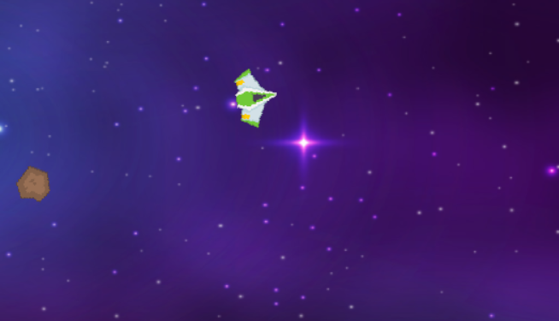
Spaceship Movement
Spaceship Movement
Player 1
Player 2
W
↑
A
S
D
←
↓
→

